Slide 1
CASE STUDY – RENEWABLE ENERGY
Business Scenario
Developing an easily scalable renewable energy solution consisting of different types of predictive analytics use-cases for plant and equipment's such as Pyranometer, Inverter, Transformer and SCB's.
It requires a great expertise in the field of statistics, deep learning, and significant knowledge of domain. Client was using Scada system to generate data of sensors present at different assets in plant. Power BI reports were reporting tool and Cosmos DB has been used for storing transactional and modelling data.
Impact
Improve performance and reliability.
Cost reduction by optimizing resource allocation on the assets that matter most.
Transform network data into a condition-based asset-management strategy driven by the health and criticality of a utility’s assets.
Proprietary power modeling tools evaluating policy, energy trends, and forecasts for scenario analysis.
80%+ accuracy over failure and anomaly prediction for all the equipment’s.
Solution
Predictive Analytics of Assets, that include Fault Diagnostics (Anomaly Detection), Fault Classification, Fault Prediction, Probable Reason of Failure/Remaining useful life of Assets.
Generation-portfolio management and Power modelling that include Expected Generation, Losses Analysis, Performance of Plot Month on Month and Day wise Analysis.
To deploy 15000MW Plots across different locations of India, currently we are using 20 containers with 300 collections and 15000 RU’s in Cosmos DB

Slide 2

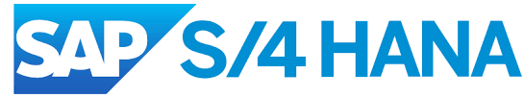



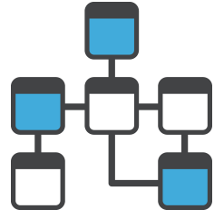
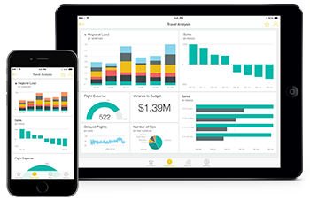





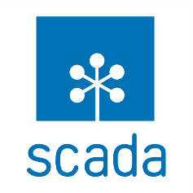

CASE STUDY – TECHNICAL ARCHITECTURE
Source
Data Ingestion
EDW and Data Modelling
Reporting
Azure Databricks
RDBMS(non-SAP applications)
SHIR
Azure Data Factory
Azure Data
Lake
Azure Synapse
Power BI Dashboards
Cosmos DB
Azure ML
Real-time Feed
Industrial Data
Sensor Data
Scada System
Azure IoT Hub

